Slide 1


CLOUD ARCHITECT PRESENTATION
Enterprise Multi-Cloud Architecture & IaC
Building Secure, Scalable, and Fault-Tolerant Systems
Cloud Architect Team
Q3 2024 Strategy

Slide 2






Solution Pillars
Security
Availability
Fault Tolerance
Scalability
Zero-trust posture with private endpoints & firewalls.
Multi-zone redundancy for zero-downtime operations.
Graceful degradation through isolated domains.
Dynamic provisioning for elastic enterprise workloads.

Slide 3

Application Architecture
Distributed Workflow
Microservices Mesh
Edge Acceleration
Insert Application Architecture Diagram and workflow details here.

Slide 4
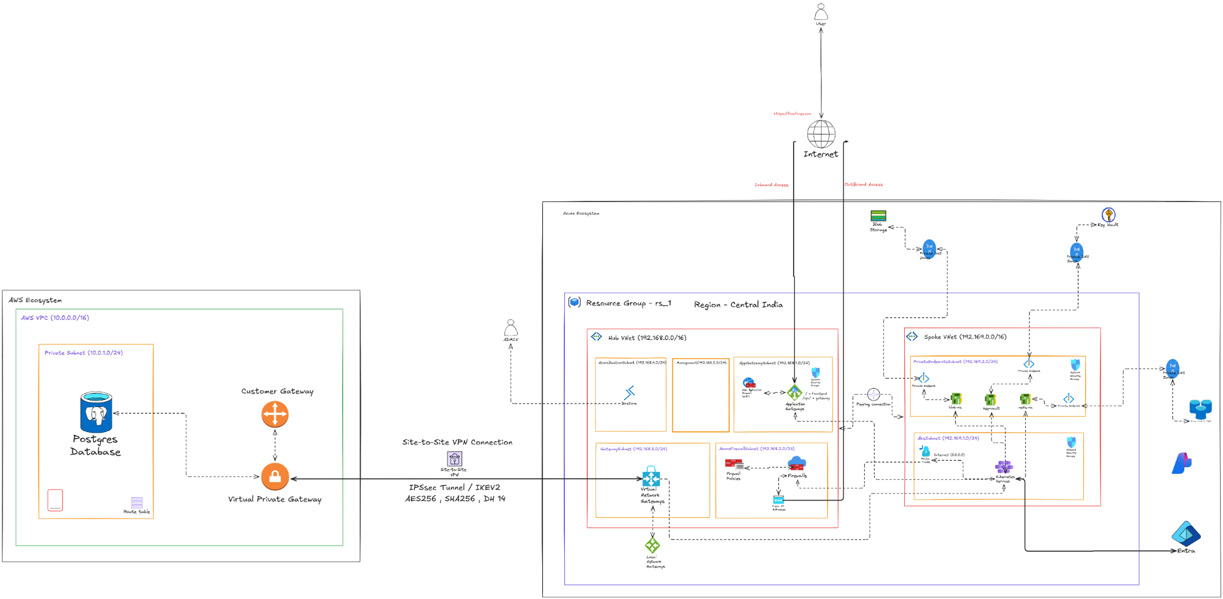

Slide 5

Terraform: Modularity
Code Modularity
Structure
Custom Modules: Standardized, reusable components for compute/network.
Provider Layer: Defines global API credentials and versions.
DRY Logic: Centralized resource definitions to minimize duplication.
Module Layer: High-level abstractions (VPC, Cluster, DB).
Provider Isolation: Separate directories for Azure and AWS resources.
Environment Layer: Orchestrates cross-provider deployment.

Slide 6

Dynamic Environments
Variable Injection: Use of dev.tfvars and prod.tfvars for environment-specific values.
One Codebase: Deploy the same HCL code to different tiers without modification.
Scaling Controls: Vary instance sizes and node counts per environment dynamically.

Slide 7

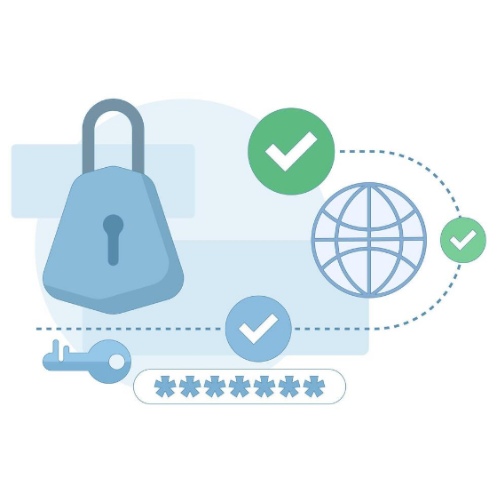

State Management
Remote Backend
Azure Blob Storage: Centralized storage for .tfstate files.
State Locking: Lease mechanism prevents concurrent state modification.
Corruption Prevention: Avoids race conditions during team deployments.
Security: State encrypted at rest with managed identities.

Slide 8

Questions?
Open floor for technical deep-dive and architectural review.
architecture@enterprise.io | github.com/org/terraform-iac

Slide 9




Image Sources
https://miro.medium.com/v2/resize:fit:1400/1*NQQ8zqjm535SdM-687-o_w.png
Source: mehmetozkaya.medium.com
https://cdn.cloudairy.com/blog/1772687728898Top%208%20Cloud%20Architecture%20Diagrams%20for%20Modern%20Enterprises.webp
Source: cloudairy.com
https://learn.microsoft.com/en-us/training/achievements/terraform/terraform-introduction-to-infrastructure-as-code.svg
Source: learn.microsoft.com
https://static.vecteezy.com/system/resources/previews/063/055/671/non_2x/cloud-security-and-data-protection-concept-online-security-information-confidentiality-cloud-storage-network-protection-passwords-keys-personal-identification-flat-illustration-vector.jpg
Source: www.vecteezy.com

